Slide 1

Department of Information Technology
NBA Accredited A.P. Shah Institute of Technology G.B.Road,Kasarvadavli, Thane(W), Mumbai-400615 UNIVERSITY OF MUMBAI Academic Year 2021-2022

Slide 2
A Project Presentation on Smart Investment Predictor(MoneyCanny) Submitted in partial fulfilment of the degree of Bachelor of Engineering(Sem-6) in INFORMATION TECHNOLOGY By Atharv Joshi(19104036) Siddhesh Puranik(19104014) Niranjan Ram(19104025) Under the Guidance of Prof. Vishal Badgujar

Slide 3
1.Project Conception and Initiation

Slide 4
1.1 Objectives
To help user make the right investment choice.
To display the different markets.
To educate the user about different investment options.
Make a list of investments and track them.
To give personalized user experience.

Slide 5
1.2 Literature Review
Sr.no | Author Name | Paper Title | Publication | Findings
1 | F. G. D. C. Ferreira, A. H. Gandomi and R. T. N. Cardoso | "Artificial Intelligence Applied to Stock Market Trading: A Review" | IEEE Access, vol. 9, pp. 30898-30917, 2021 | It is possible to use Artificial intelligence algorithms (regression) to predict the stock market.
2 | Dharmendra Singh | Causal Relationship Between Macro-Economic Variables and Stock Market: A Case Study for India | Pakistan Journal of Social Sciences (PJSS) Vol. 30, No. 2 (December 2010), pp. 263-274 | The Singapore market deeply affects the Indian stock market.

Slide 6
1.2 Literature Review (Contd.)
3 | W. Yiying and Z. Yeze | "Cryptocurrency Price Analysis with Artificial Intelligence," | 2019 5th International Conference on Information Management (ICIM), 2019, pp. 97-101, doi: 10.1109/INFOMAN.2019.8714700. | Algorithms like LSTM and Artificial Neural Networks can be used to study and predict the trends in the cryptocurrency market

Slide 7
1.3 Problem Definition
The user is inexperienced with investing their money so they have to find a reliable source of information. The user is also confused in which type of investment he would get better returns. Thus the solution is to come up an app which can predict returns on different Investment options and compare them.

Slide 8
1.4 Scope
Can be useful to any beginner in Investment field
Can be used by students to learn about different investment options for the future
Can be used to store the user profile and suggest the investment options based on that.

Slide 9
1.5 Technology stack
Front End- Flutter (App)
Backend- Python, Google Sheets and
Database - Firebase

Slide 10
2. Project Design

Slide 11
2.1 Proposed System
The system we have proposed is an app made in flutter which displays the change in market in terms of percentages at the end of the day.
The app takes the data from different APIs and stores them in a google sheet.
We take that data and run it through our algorithm and display it in terms of percentages in our flutter app.

Slide 12
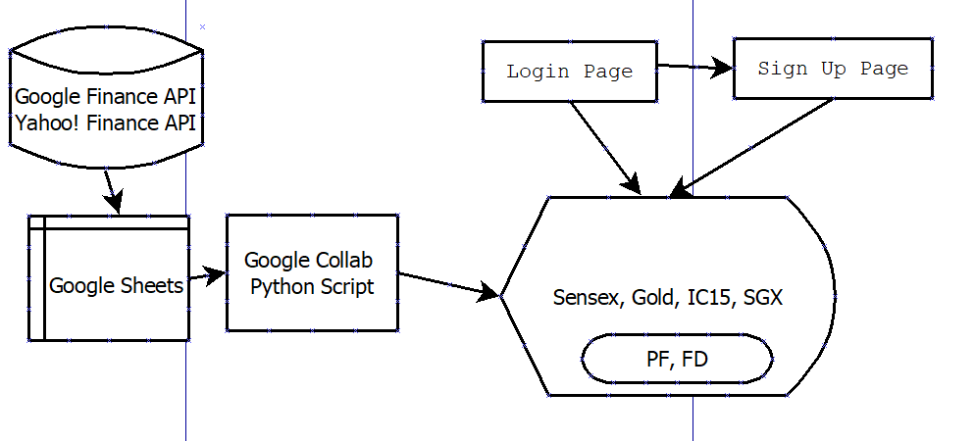
2.2 Flow of Modules

Slide 13
3. Implementation

Slide 14
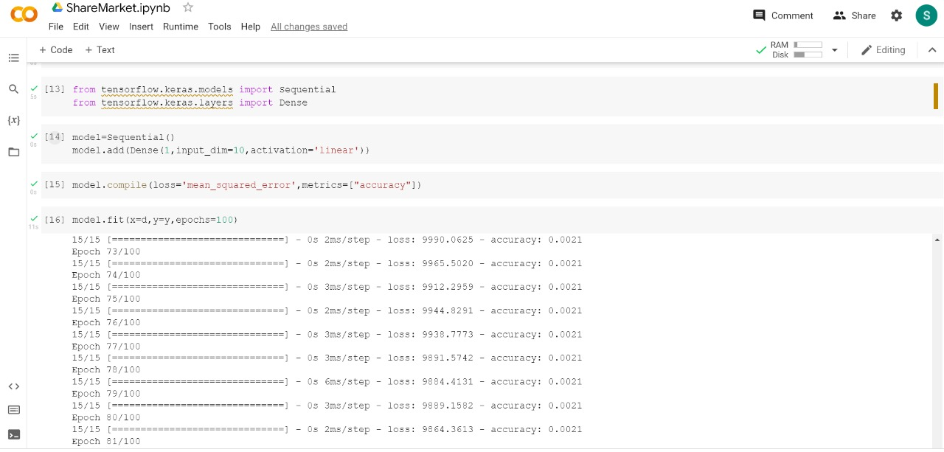
Linear model using Tensorflow

Slide 15
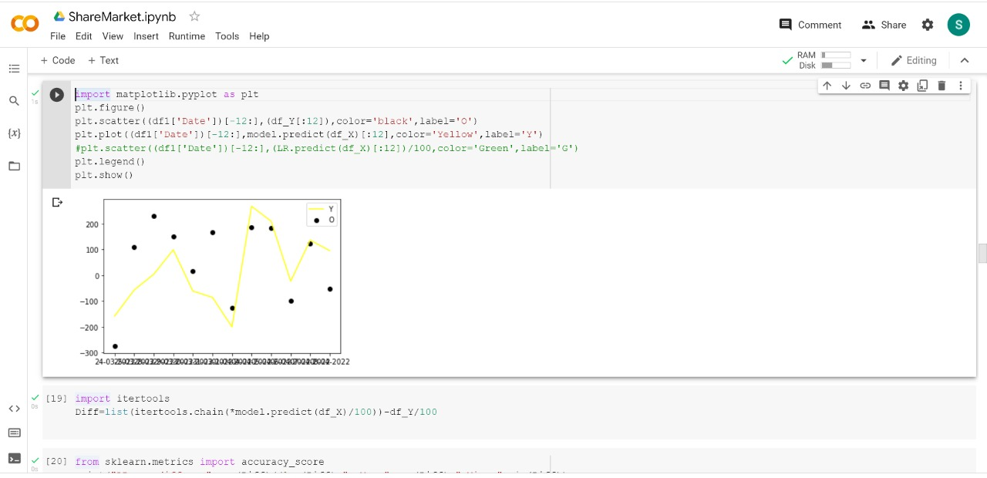
Prediction of Sensex using that model

Slide 16
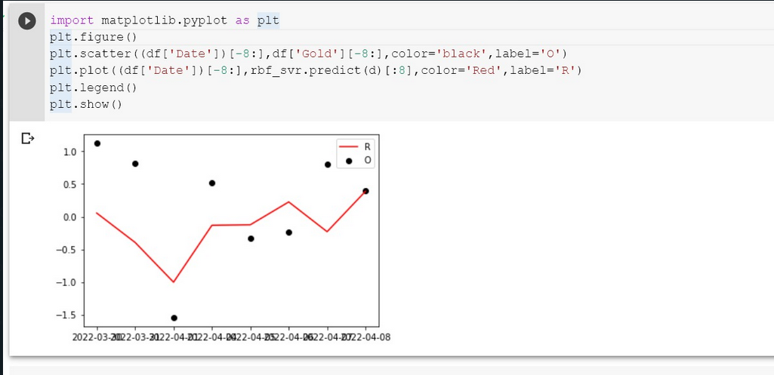
Gold Data prediction

Slide 17
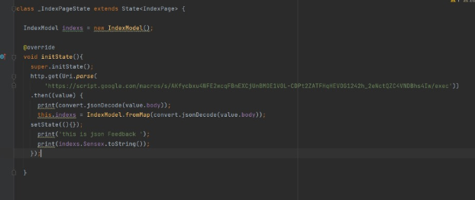
Fetching data from google sheet and storing.

Slide 18
4. Result

Slide 19
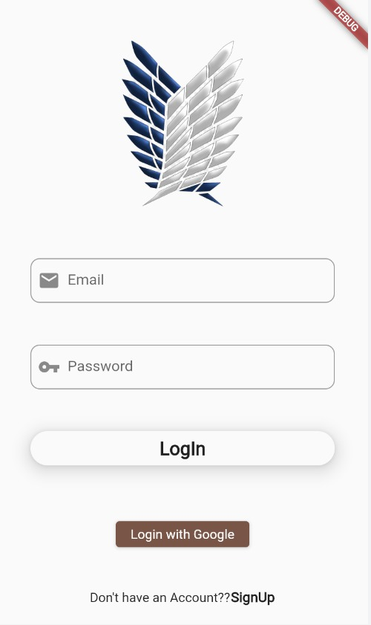
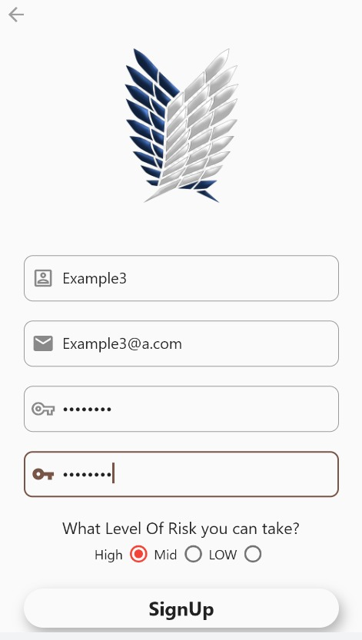
Login and Signup pages

Slide 20
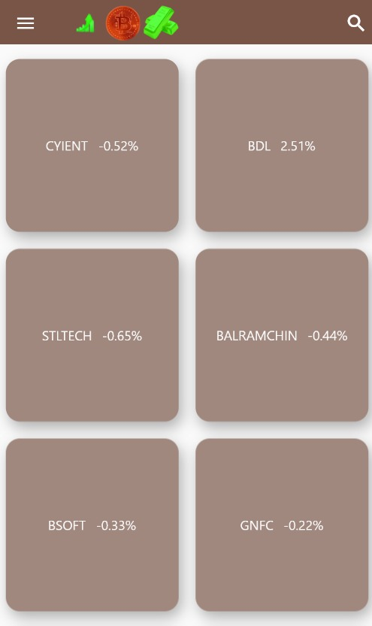
INDEX PAGE
Top Stocks are displayed with their rate of change

Slide 21
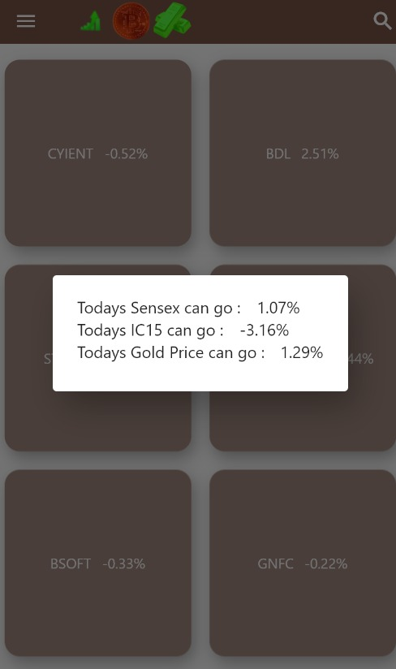
On clicking the AppBar

Slide 22
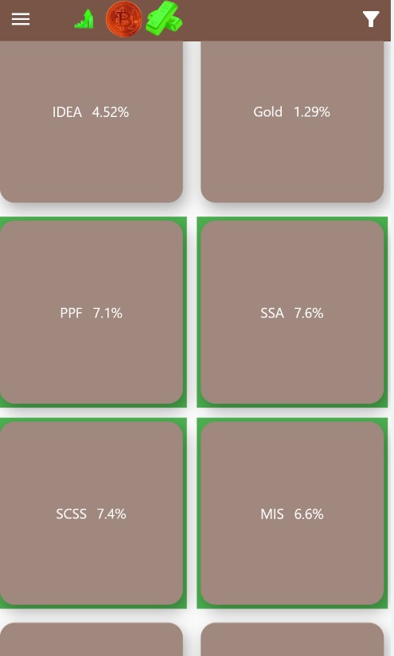
Government Schemes are highlighted

Slide 23
5. Conclusion and Future Scope

Slide 24
5.1 Conclusion
Thus we have made an app which predicts the market and displays the results in terms of percentages. The user can also view the static investment options like PF and FD.

Slide 25
5.2 Future Scope
The app can be fully developed to display finance related news
Sentiment analysis of that news can be used to further predict the market
Educative tips and information can be added to the App
Can be deployed as a full fledged app.

Slide 26
6. References
https://docs.flutter.dev/
Book: Beginning Progressive Web App Development by Dennis Sheppard
Book: Artificial Intelligence A Modern Approach by Stuart Russell and Peter Norvig
"Artificial Intelligence Applied to Stock Market Trading: A Review” by F. G. D. C. Ferreira, A. H. Gandomi and R. T. N. Cardoso
Causal Relationship Between Macro-Economic Variables and Stock Market: A Case Study for India by Dharmendra Singh
"Cryptocurrency Price Analysis with Artificial Intelligence“ by W. Yiying and Z. Yeze

Slide 27
Thank You

